Slide 1

Database as a Service: Delivering Database as a Service
Ashish Khettry
Senior Sales Consultant
Social. Mobile. Complete.

Slide 2
Agenda
Current challenges
Delivering dbaas
Lifecycle-driven approach
References and Case Studies

Slide 3

Current State of Database Deployments Siloed, Dispersed, Varied and Complex
Ever growing database population
Multiple versions and patch levels
Compliance challenges
Poor resource utilization
High cost of deployment and operation
DATABASE ESTATE
28% have an annual database instance growth of more than 20%
Less than 50% have consolidated
*IOUG Survey, 2013

Slide 4






Current Database Provisioning Process
Time-consuming and Inefficient
… Days to Weeks …
Developer | Request DB |  |  |  | Get access to DB
Manager | Approval
DBA |  | Request HW and Storage |  | Configure Cluster and create DB
System Admin |  |  | Setup OS & network
Storage Admin |  |  | Allocate Storage

Slide 5
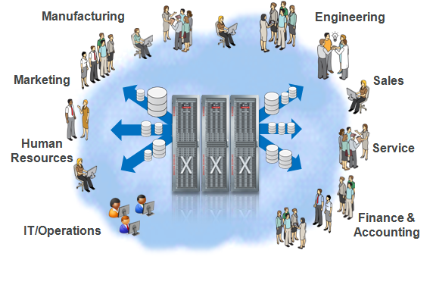
DBaaS Goal - the Best of On-Premise & Cloud Give Everyone What They Want Most
Users Want
Easy self-service DBaaS
Metered use
Performance optimized for service levels
IT Wants
Simplified deployment on standardized platforms
Less maintenance and better support
More budget and time for innovation
DBaaS

Slide 6
DBaaS: Salient Features
Database-as-a-Service provides
A shared, consolidated platform to provision database services on
Self-Service provisioning
Scale-up, scale-down, retirement and relocation services
Chargeback based on database usage
Database-as-a-Service needs to cater to various use cases
A developer or a project owner requiring a new database service with(out) seed data
QA requiring a full database refresh for intense load testing
QA requiring to create multiple clones for functional testing on subset of data

Slide 7


Deliver DBaaS Through Enterprise Manager 12c

Slide 8

Deliver DBaaS via a Lifecycle Approach
4. Meter, Charge, Optimize
Meter resource utilization
Chargeback/Showback
1. Plan & Setup the DB Cloud
Capacity & consolidation planning
Asset discovery
Setup Resource Pools
Setup Policies
Applications and
Business Services
Database
Platform
3. Manage & Monitor
Database monitoring
Configuration management
Full stack management
Infrastructure
2. Enable Self-Service
Define Service Catalog
Enable Service Governance
Enable integration via APIs

Slide 9
Deliver DBaaS
1. Plan & Setup the DB Cloud

Slide 10
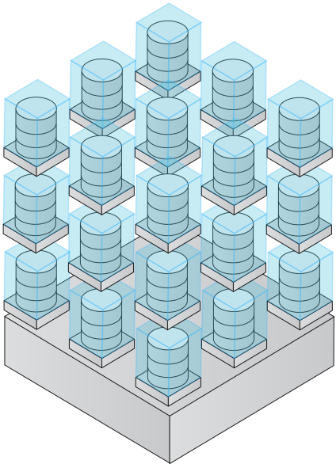
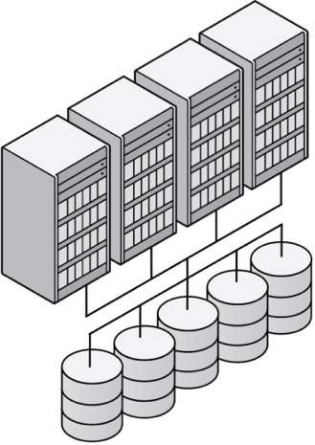
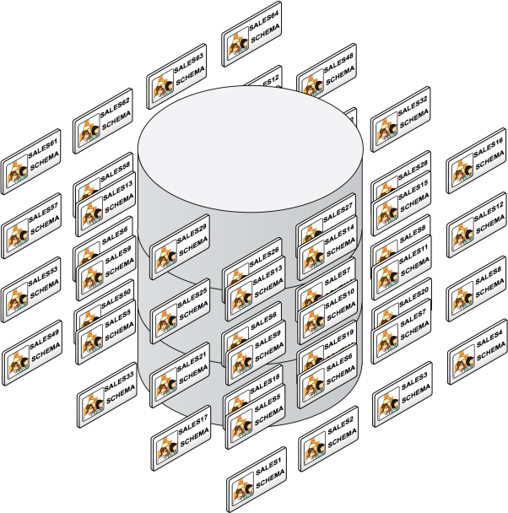
DBaaS Consolidation Models
Pre- Oracle Database 12c
Virtual Machines
Dedicated Databases
Schema Consolidation
Server Consolidation
Deploy in dedicated VMs
OVM, Solaris
Platform Consolidation
Share server pool
Real Application Clusters
Database Consolidation
Share databases using Schema
Increasing Consolidation
Notes:
Schemas downside is: not app transparent, no isolation

Slide 11

Oracle Database 12c Pluggable Databases
New architecture for consolidating databases on Clouds
No application changes
Isolation and multitenancy
Container Database
Fast provisioning and cloning
Secure and highly available
ERP
CRM
DW
Lower IT costs
Manage many as one
Greater resource utilization
Performant and scalable

Slide 12

Comparison of DBaaS Consolidation Models
 | Virtual Machines | Dedicated DB | Dedicated Schemas | Pluggable DB
Consolidation Density | Low-Moderate | High | Highest | Highest
Maintenance | Very complex (VM Sprawl) | Easy | Easy to Involved (based on required resource isolation) | Easy
Isolation | Excellent | Good | Least | Good
Implementation & Onboarding | Easy | Easy | Difficult | Easy
Application Suitability | Some (workload dependent) | All | Home grown; requires app validation | All but have to be certified for Database 12c

Slide 13

Modeling DBaaS Resources
Database Resource Pool
A group of homogeneous clustered or non-clustered resources exhibiting common characteristics. Example:
Pool of 11.2 Database Oracle Homes (for dedicated databases)
Pool of 12c Container Databases (for PDBs)
Zone
A logical grouping of cloud infrastructure resources based on QOS, functional, departmental or geographic boundaries. Example, Finance Zone, East Coast Zone
Self-Service users provision into a Zone
Zones can also be used to enforce access control and chargeback
11.2 DB OH Pool
10.2.0.4 DB Pool
Production Zone
12c CDB Pool
11.2 DB Pool
Dev Zone
11.2 RAC DB Pool
11.2 RAC DB Pool
10.2 DB Pool
Test Zone

Slide 14
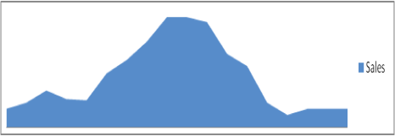

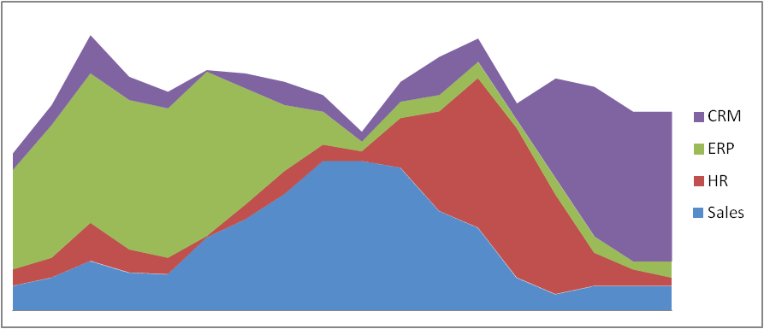
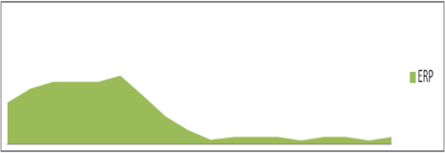
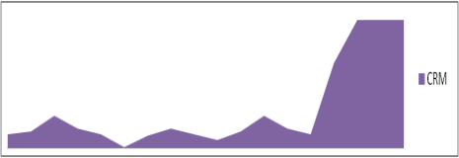
Planning and Migrating Existing Apps to DBaaS
Database Consolidation Planner & Consolidated Replay
Discover existing databases through automated discovery
Leverage Database Consolidation Planner
Consolidate multiple source databases
Based on technical metrics and business constraints
Single Instance, RAC, non-CDB and multi-tenant databases
Test applications through Consolidated Replay
Concurrent replay of workload captured on different databases
SALES
HR
ERP
CRM
Consolidated Workload Replay
Workload

Slide 15
Deliver DBaaS
2. Enable Self-Service

Slide 16


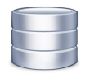
Identifying Use Cases for Provisioning
User needs a new database service with or without seed data
User deploys a dedicated database inside a VM or on physical
Pros: Resource isolation, ideal for enterprise applications like ERP
Cons: VM and database sprawl, administrative overheads, compliance challenges
User deploys a database schema or a pluggable database
Pros: High consolidation, minimal administrative and maintenance overhead
Cons: Limited isolation for schemas
2. User needs a clone of an existing database for testing
User makes a full clone of database
Pros: Ideal for load-testing with significant data updates
Cons: Time and space consuming
User makes a thin-clone (using ‘Copy On Write’) of database
Pros: Minimal additional space, instantaneous cloning, ideal for functional testing
Cons: Reduced benefits in case of significant data updates

Slide 17
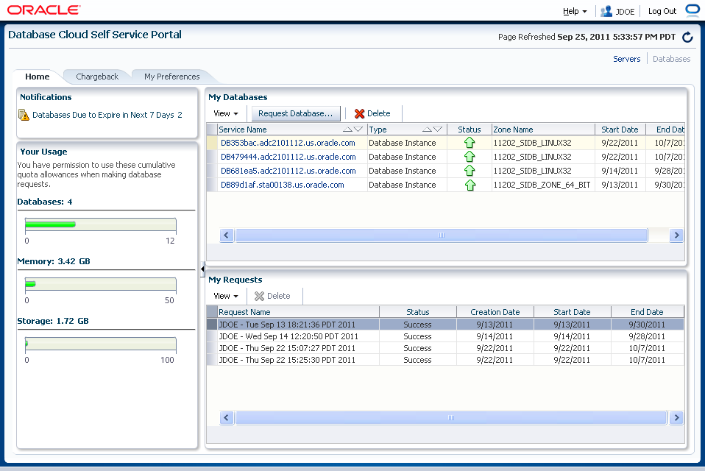
Self-Service Provisioning via EM12c
Self-Service provisioning of dedicated databases, Pluggable DBs and Schema
Automated, intelligent placement based on workload and configuration
Self-Service catalog with governance using quotas, retirement policies, showback
Flexible cloning architecture
Full data cloning by leveraging backups
Instant database provisioning using “SnapClone” thin provisioning with minimal storage footprint on Netapp, ZFS (Hitachi and EMC planned)
Integrated solution for database lifecycle management: monitoring, backup, patching
API-driven (RESTful and command line)

Slide 18








Database as a Service (DBaaS)
Self-service driven provisioning of Pluggable databases
Oracle Enterprise Manager
Self-Service
Governance
Intelligent placement
Chargeback
GOLD
RAC, Data Guard
Data Guard
SILVER
L
XL
BRONZE
Single instance Databases
S
M
M
✔
✔
Notes:
Play this slide click-by-click, explaining choices on the way.
Compare: Dedicated database – new backup required;
Schema consolidation – manage many as one with no agility.

Slide 19
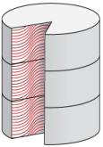
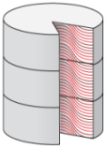

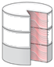
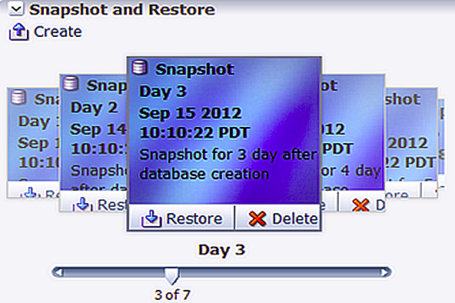
DBaaS “Snap Clone”
Data Cloning in Minutes
Production Database
Masking & Sub setting
Test Master Database
Features
Leverage storage copy on-write technologies fast provisioning
Initial support for NAS (Oracle ZFS Appliance and Netapp)
Integrated lifecycle management (lineage and association tracking)
“Time travel” capability to restore and access past data
Benefits
Agile provisioning (~ 2 minutes to provision a 1 TB database)
Over 90% storage savings (100 KB of additional space for cloning a 1 TB database)
Reduced administrative overhead from integrated lifecycle management
010110011 101001010
000111010

Slide 20
Self-Service Portal APIs Comprehensive RESTFUL APIs for Integration and Orchestration
List Zones
List service templates
List service instances
Request DBs
Request PDBs
Request schemas
Track request progress
List
Deploy
DBaaS
Portal & API
Delete service
Extend reservation
Service Control (start/stop)
Backup
Restore
Snapshot
Get chargeback info
Delete
Manage

Slide 21
Deliver DBaaS
3. Manage & Monitor

Slide 22
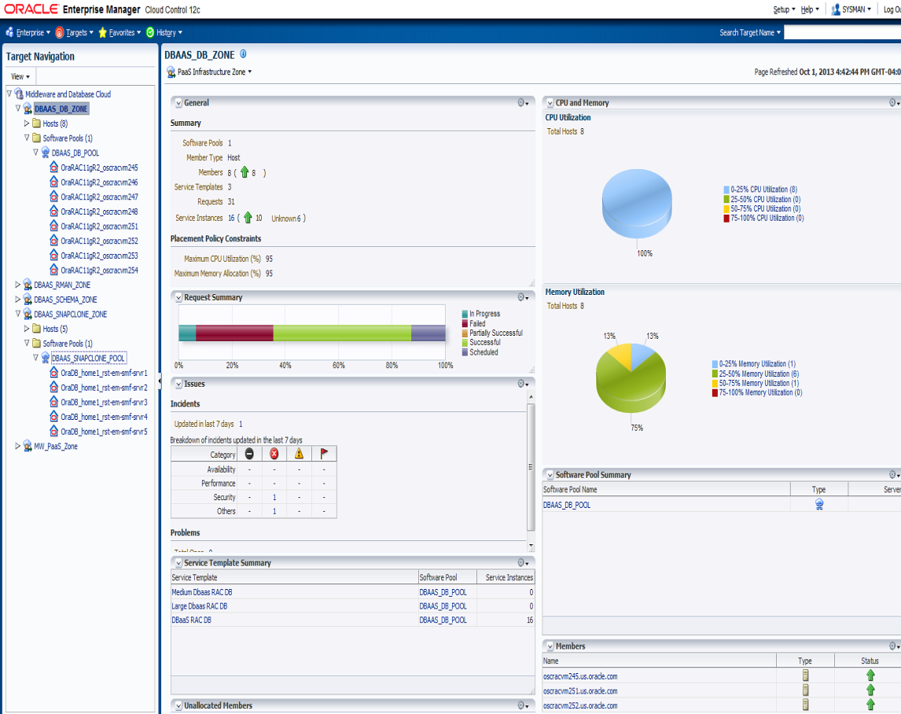
Cloud Resource and Request Management
Manage Cloud Zones and underlying resources
Database Pools, servers, storage
Track resource flux, tenants, policy violations, etc
Drill down into individual resources for deeper monitoring
Monitor requests and failure rates and identify potential bottlenecks to remediate
Deep software and hardware management for Exadata

Slide 23
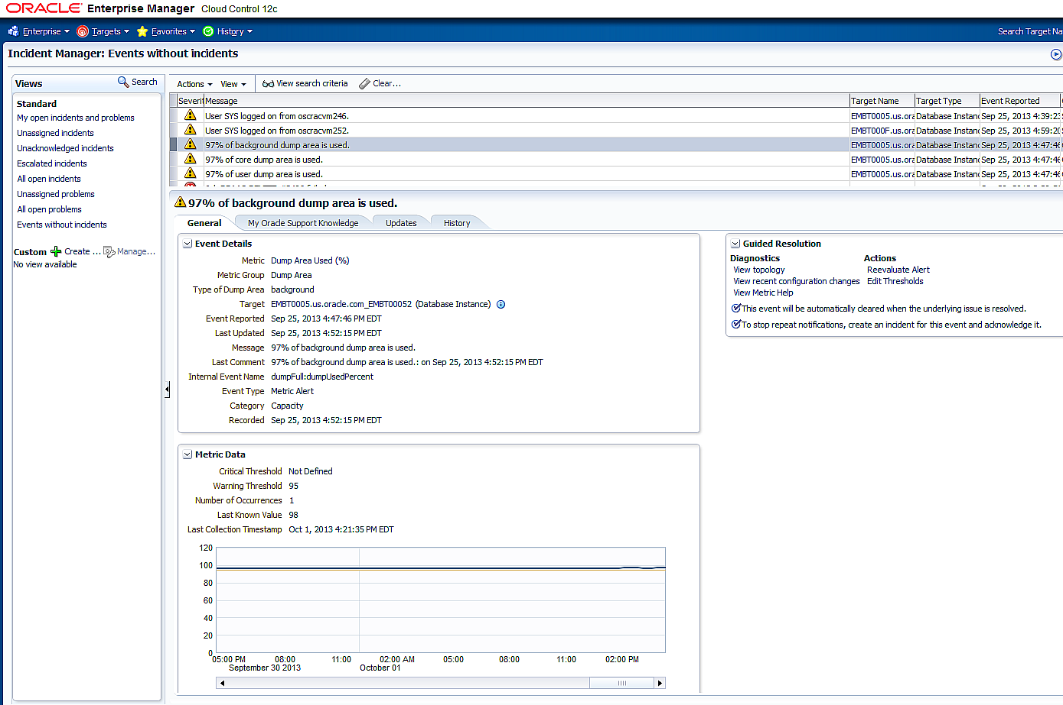
Incident Management Through EM 12c Incident Manager
Setup and apply monitoring templates based on desired SLAs
Manage exceptions
View, manage, diagnose and resolve incidents from one console
Assign, acknowledge, prioritize, track status, escalate, suppress
Accelerated resolution with “My Oracle Support” integration
Integrated with external Helpdesk Systems
Out of box connectors for Remedy, HP Service Center

Slide 24
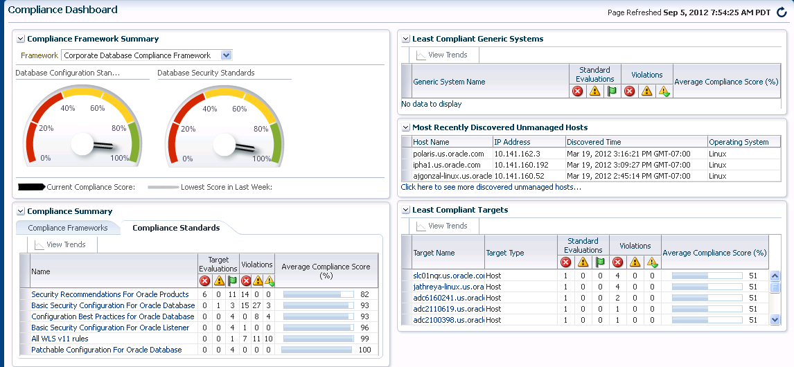
Compliance and Patch Management
Compliance Management with Dashboard maintains and displays up to date compliance score
Automated reporting of compliance against Oracle Best Practices and internal standards covering Exadata, RAC, Single Instance, Pluggable databases and underlying infrastructure
Automated drift control against golden standards
Can be mapped to CIS, PCI or other frameworks
Comprehensive Patch Management
Advisories, pre-flight analysis, execution and reporting
Minimize downtime by applying many patches to many database targets at a time

Slide 25
Deliver DBaaS
4. Meter, Charge, Optimize

Slide 26
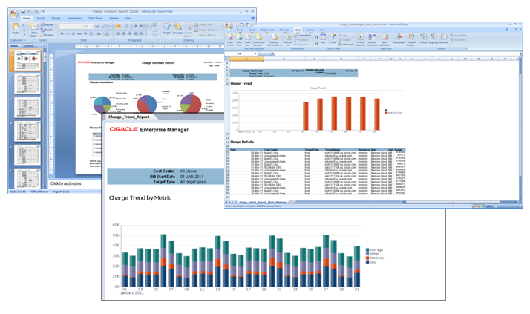
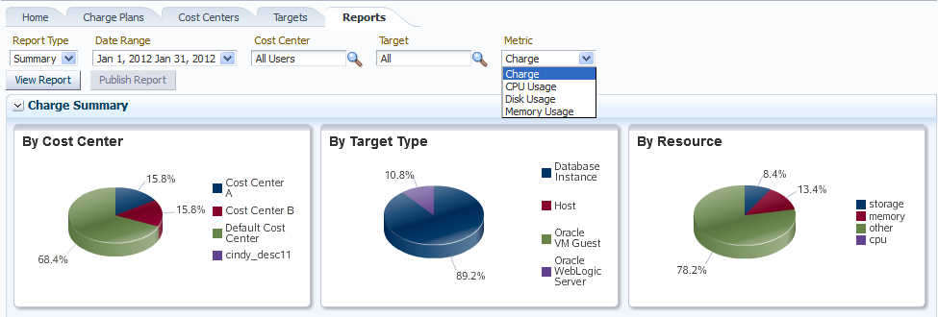
Metering and Chargeback Tailored for different use cases and user types
Showback based on fixed, utilization or configuration
Can be extended to leverage other metrics, e.g: business transactions
Rollups based on LDAP
Tailored reporting for different user personas
Chargeback Administrator
Self-Service Portal User
Line of Business User

Slide 27
Database Metrics for Chargeback
 | Database Instance | Shared Database (Service)
Configuration | Edition Memory Usage Option Storage Usage Release Version RAC Node Count | Option Edition Release RAC Node Count
Usage | CPU Time CPU Utilization (%) CPU Utilization (SPECInt) Network IO Disk Read (Physical) Operations Disk Write (Physical) Operations SQL Executes User Transactions | CPU Time Per Service CPU Utilization Per Service DB Time Per Service Disk Read (Physical) Operations Per Service Disk Write (Physical) Operations Per Service SQL Executes Per Service User Transactions Per Service

Slide 28
Oracle DBaaS: Key Differentiators
Most comprehensive solution set
Different forms of DBaaS
Integration with other service types, such as MWaaS
Delivers great ROI and business value by going far beyond virtualization and infrastructure
Complete cloud lifecycle management using a single tool
Eliminates complexity, integration needs
Pioneering, most mature engineered systems
Provide the fastest path to cloud transformation
Proven products, validated solution blueprints
Based on real implementations including Oracle Cloud Services

Slide 31
声明：
所有的版权属于原有公司，文件均来自公开渠道
此文件仅供学习使用，任何人不得进行以此为商业目的的行为
如有疑问，请立即删除
学习世界五百强和咨询公司PPT课程请访问如下网站搜索：“司马懿”
百度传课：司马懿PPT学校
https://www.chuanke.com
网易学堂：司马懿PPT学校
https://study.163.com
知乎： 司马懿PPT学校
https://www.zhiu.com

Slide 32
声明：
所有的版权属于原有公司，文件均来自公开渠道
此文件仅供学习使用，任何人不得进行以此为商业目的的行为
如有疑问，请立即删除
学习世界五百强和咨询公司PPT课程请访问如下网站搜索：“司马懿”
百度传课：司马懿PPT学校
https://www.chuanke.com
网易学堂：司马懿PPT学校
https://study.163.com
知乎： 司马懿PPT学校
https://www.zhiu.com

